Slide 1
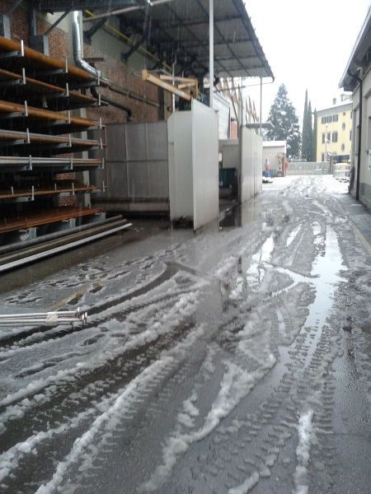
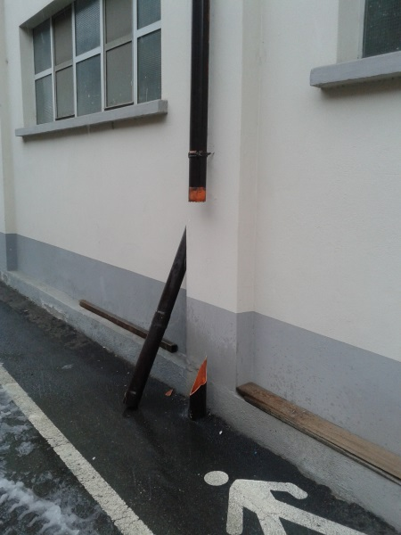
HS&E INCIDENT BULLETIN |  | January - September 2015
Location Country | Type of incident (example: Slip-Trip, Fall from Height, Vehicle , Laceration, Chemical Exposure)
Summary:
There was snow on a road; during handling of piping, the driver lost control of the forklift truck, hitting the building and causing some damage to the plumbing system
Root Causes: | Actions Taken Thus Far: Next Steps
Bad weather due heavy snowfall Front tires without tread | Immediate replacement of tires of forklift truck involved; Check the tires of all forklifts used in the Company; Use of salt at ground to dissolve snow

